Slide 1
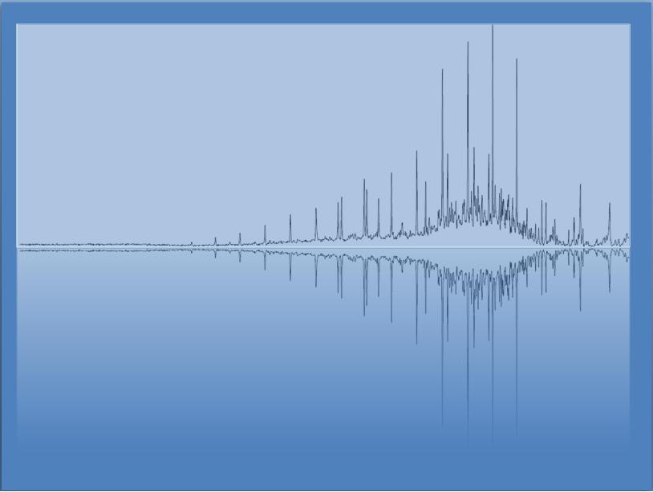
Equilibrium
Chem 3A- Yates

Slide 2
Outline
The concept of Dynamic Equilibrium
The Equilibrium Constant
Heterogeneous Equilibria and Ksp
LeChatlier’s Principle

Slide 3
Demo

Slide 4
Chemical Equilibrium
Many chemical reactions do not react to completion.
Equilibrium is the point where the amounts of products and reactants stop changing.
The forward and reverse reactions continue, but at the same rate

Slide 5
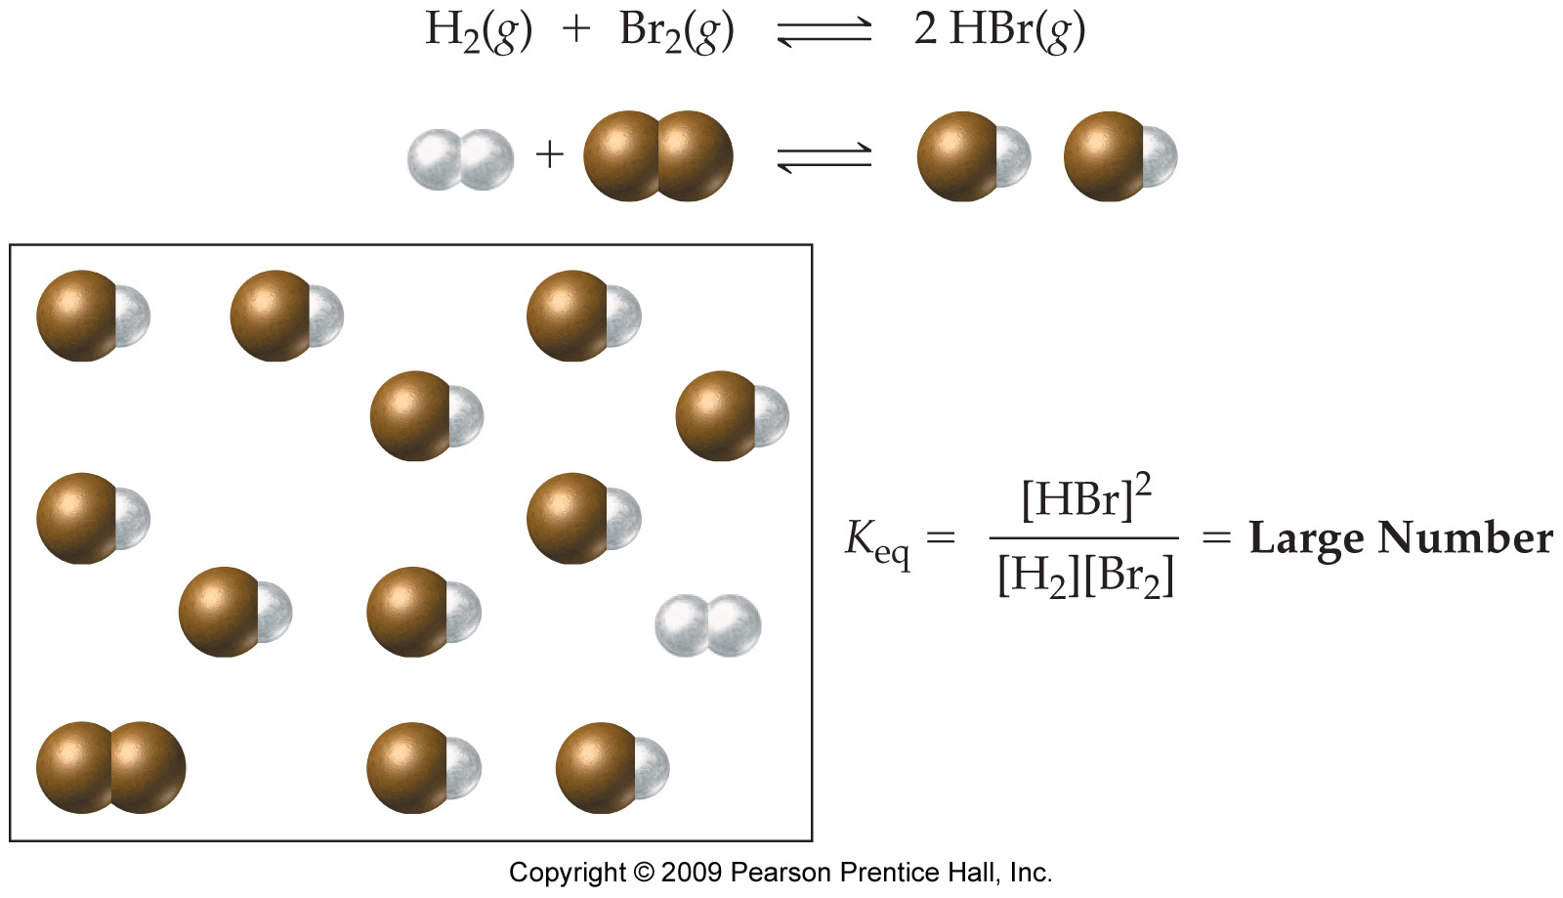
A Large Equilibrium Constant (Equilibrium Favors Products)

Slide 6
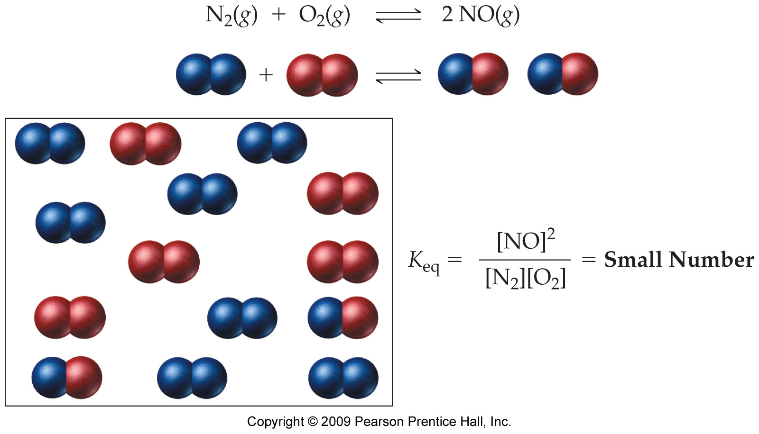
A Small Equilibrium Constant (Equilibrium Favors Reactants)

Slide 7
Outline
The concept of Dynamic Equilibrium
The Equilibrium Constant
Heterogeneous Equilibria and Ksp
LeChatlier’s Principle

Slide 8
Equilibrium Constant
For the general equation aA + bB ⇔ cC + dD, the relationship is given below:
The equilibrium constant, K_{eq}.
*Always Products / Reactants

Slide 9
Equilibrium Constant
For the reaction H₂(g) + I₂(g) ⇔ 2HI(g) at equilibrium.
Products
Reactants

Slide 10
Equilibrium Constant
For the reaction H₂(g) + I₂(g) ⇔ 2HI(g) at equilibrium.
Products
Reactants

Slide 11
A Large Equilibrium Constant (Equilibrium Favors Products)

Slide 12
A Small Equilibrium Constant (Equilibrium Favors Reactants)

Slide 13
Write the Equilibrium Constant Expressions, K_{eq}, and Predict the Position of Equilibrium for Each of the Following:
2 SO₂(g) + O₂(g) ⇔ 2 SO₃(g) K_{eq} = 8 x 10²⁵
N₂(g) + 2 O₂(g) ⇔ 2 NO₂(g) K_{eq} = 3 x 10⁻¹⁷

Slide 14
Write the Equilibrium Constant Expressions, K_{eq}, and Predict the Position of Equilibrium for Each of the Following, Continued:
2 SO₂(g) + O₂(g) ⇔ 2 SO₃(g) K_{eq} = 8 x 10²⁵
N₂(g) + 2 O₂(g) ⇔ 2 NO₂(g) K_{eq} = 3 x 10⁻¹⁷
Favors products.
Favors reactants.

Slide 15
Calculate K_{eq} for the Reaction 2 NO₂(g) ⇔ N₂O₄(g) at 100 °C if the Equilibrium Concentrations Are [NO₂] = 0.0172 M and [N₂O₄] = 0.0014 M.

Slide 16
Find the Value of K_{eq} for the Reaction 2 NO₂(g) ⇔ N₂O₄(g).
Given:
Find:
[NO₂] = 0.0172 M, [N₂O₄] = 0.0014 M
K_{eq}
Solution Map:
Relationships:
[NO₂], [N₂O₄]
K_{eq}
Solve:
Check:
K_{eq} is unitless.

Slide 17
A Sample of PCl₅(g) Is Placed in a 0.500 L Container and Heated to 160 °C. The PCl₅ Is Decomposed into PCl₃(g) and Cl₂(g). At Equilibrium, 0.203 Moles of both PCl₃ and Cl₂ Are Formed. Determine the Equilibrium Concentration of PCl₅ if K_{eq} = 0.0635.

Slide 18
A Sample of PCl₅(g) Is Placed in a 0.500 L Container and Heated to 160 °C. The PCl₅ Is Decomposed into PCl₃(g) and Cl₂(g). At Equilibrium, 0.203 Moles of PCl₃ and Cl₂ Are Formed. Determine the Equilibrium Concentration of PCl₅ if K_{eq} = 0.0635, Continued.
PCl₅ ⇔ PCl₃ + Cl₂
Equilibrium Concentration, M | ?
Notes:
if in addition you calculate K_{p} from K_{c} you find that it is 2.26, slightly greater than 1 – showing that the equilibrium constant may be unreliable for predicting the position of equilibrium when it is close to 1

Slide 19
Outline
The concept of Dynamic Equilibrium
The Equilibrium Constant
Heterogeneous Equilibria and Ksp
LeChatlier’s Principle

Slide 20
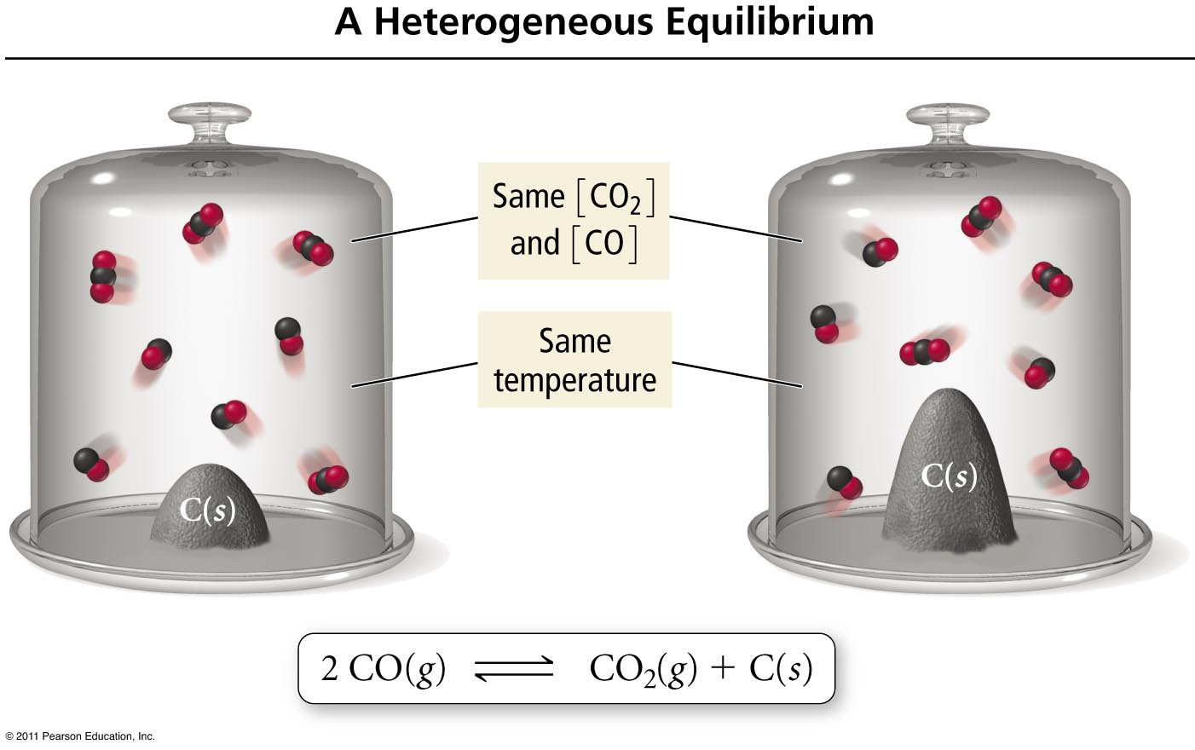
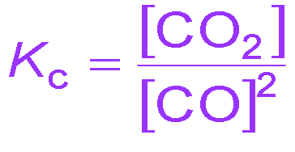
Heterogeneous Equilibria
Only concentrations of elements and compounds in the reaction mixture are included in Keq.
* Usually (g) and (aq)
Concentrations of pure chemicals are not included.
* Usually (s) and (l)

Slide 21
Write the Equilibrium Constant Expressions, K_{eq}, for Each of the Following:
2 CO₂(g) ⇔ 2 CO(g) + O₂(g)
BaSO₄(s) ⇔ Ba⁺²(aq) + SO₄⁻²(aq)
CH₄(g) + 2 O₂(g) ⇔ CO₂(g) + 2 H₂O(l)

Slide 22
Write the Equilibrium Constant Expressions, K_{eq}, for Each of the Following
2 CO₂(g) ⇔ 2 CO(g) + O₂(g)
BaSO₄(s) ⇔ Ba⁺²(aq) + SO₄⁻²(aq)
CH₄(g) + 2 O₂(g) ⇔ CO₂(g) + 2 H₂O(l)
[CO]²•[O₂]
[CO₂]²
K_{eq} =
K_{eq} =
[Ba⁺²]•[SO₄⁻²]
[CO₂]
[CH₄]•[O₂]²
K_{eq} =

Slide 23
Outline
The concept of Dynamic Equilibrium
The Equilibrium Constant
Heterogeneous Equilibria and Ksp
LeChatlier’s Principle

Slide 24


Slide 25
Le Châtelier’s Principle
“When a chemical system at equilibrium is disturbed, the system shifts in a direction that will minimize the disturbance.”
Adding reactant will cause shift to right (products) to reestablish equilibrium.
Adding product will cause shift to left (reactants) to reestablish equilibrium
Increasing pressure will shift to lower pressure by decreasing moles of gas
Increasing temperature will shift to absorb heat (left for exothermic, right for endothermic)

Slide 26
Practice – Le Châtelier’s Principle
The reaction 2 SO₂(g) + O₂(g) ⇔ 2 SO₃(g) with ΔH° = −198 kJ is at equilibrium. How will each of the following changes affect the equilibrium concentrations of each gas once equilibrium is restored?
adding more O₂ to the container
condensing and removing SO₃
compressing the gases
cooling the container
doubling the volume of the container
warming the mixture
adding the inert gas helium to the container
Tro: Chemistry: A Molecular Approach, 2/e

Slide 27
The reaction 2 SO₂(g) + O₂(g) ⇔ 2 SO₃(g) with ΔH° = −198 kJ is at equilibrium.
adding more O₂ to the container shift to SO₃
condensing and removing SO₃ shift to SO₃
compressing the gases shift to SO₃
cooling the container shift to SO₃
doubling the volume of the container shift to SO₂
warming the mixture shift to SO₂
adding helium to the container no effect

